Slide 1
CS215 DATA ANALYSIS & INTERPRETATION • GROUP 26
Sleep, Study Habits, Lifestyle Factors & Academic Performance
Multivariable regression, and Validation testing on 2,000 student profiles.
Chetan (25b0942) • Karthik (25b0976) • Mukesh (25b1009) • Rishanth (25b1044) | Mentor: Namish Bansal

Slide 2
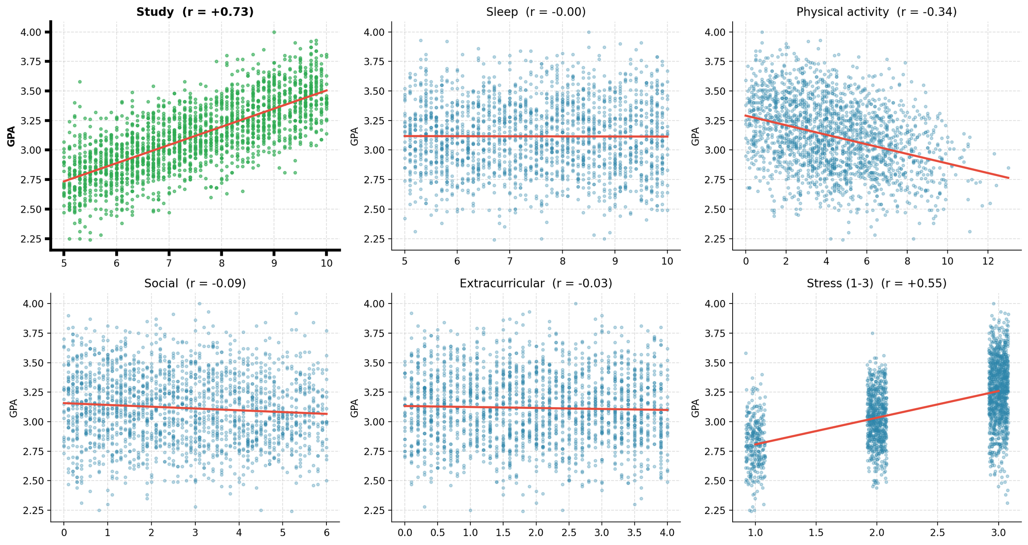

Slide 3
01 / EXECUTIVE SUMMARY
Study Hours Dominate Academic Outcomes
+0.154
GPA gain per additional daily study hour (R² = 0.54)
Sleep, physical activity, social time, and stress add zero independent predictive power.

Slide 4
01 / PROJECT GOVERNANCE
Group 26 Roles & Work Distribution
Team Member | Roll Number | Primary Work Package | Key Deliverable
Chetan | 25b0942 | Data Cleaning & Exploratory Analysis | Cleaned CSV & EDA Scripts
Karthik, Mukesh | 25b0976, 25b1009 | Statistical Modeling & OLS Regression | Multivariable Regression Models
Rishanth | 25b1044 | Importance, Interactions & Validation | Validation estimation
Namish Bansal | Project Mentor | Methodological Guidance & Review | Milestone Oversight

Slide 5
ROADMAP
Our Story in Five Parts
01
02
03
04
05
Problem Formulation
Data & Preprocessing
Exploratory Analysis
Regression & Verdicts
Limits & Reproducibility
From screen time to the variables actually recorded
2,000 students and one 24-hour constraint
Raw correlations with GPA, and why they mislead
Four models and five hypotheses tested
Simulated signatures and a one-command pipeline

Slide 6
SECTION 01
Problem Formulation & Scope Evolution

Slide 7
01 / INITIAL PROPOSAL
Initial Focus: Digital Screen Time & Sleep
Original Research Question
Do daily screen time and night-time sleep jointly influence student GPA directly or through sleep disruption?
PROPOSAL ASSUMPTIONS
Expected Dataset Columns
•
Direct Effect: Screen distraction lowers study focus.
Assumed daily screen time (2–10+ hours), sleep duration (4–9 hours), and physical activity (0–3 hours).
•
Indirect Bridge: Late-night screens reduce sleep hours.
•
Literature Basis: Hale & Guan (2015) sleep review.

Slide 8
01 / EMPIRICAL PIVOT
Proposal Assumptions vs. Actual Dataset
Initial Proposal Expectations
Actual Kaggle File Structure
•
Screen Time: Dedicated column (2–10+ h/day).
•
Screen Time: Variable completely absent.
•
Sleep Range: Wide spread (4–9 h/day).
•
Sleep Range: Restricted band (5–10 h/day).
•
Physical Activity: Narrow range (0–3 h/day).
•
Physical Activity: Broad span (0–13 h/day).

Slide 9
01 / REVISED FRAMEWORK
Five Testable Hypotheses on Recorded Variables
H0: Null Baseline
H1: Study & Sleep
H2: Social & Activity
No lifestyle variable predicts GPA.
Both positively increase student GPA.
Non-study habits alter adjusted GPA.
H3: Study × Sleep
H4: Multi-Factor Fit
Rest amplifies study effectiveness.
Full model beats study hours alone.

Slide 10
SECTION 02
Dataset Architecture & Preprocessing

Slide 11
02 / DATA INVENTORY
Kaggle Student Lifestyle Dataset Metrics
2,000
8
0
24.0h
Student Records
Recorded Columns
Missing or Duplicate Rows
Exact Daily Sum per Student

Slide 12
02 / SUMMARY STATISTICS
Variable Distributions Across 2,000 Students
Variable | Measurement Unit | Mean / Breakdown | Observed Range
GPA | Grade Point Scale | 3.12 Mean | 2.24 – 4.00
Study Hours | Hours / Day | 7.48 h/day | 5.0 – 10.0 h/day
Sleep Hours | Hours / Day | 7.50 h/day | 5.0 – 10.0 h/day
Physical Activity | Hours / Day | 4.33 h/day | 0.0 – 13.0 h/day
Social & Extracurricular | Hours / Day | 4.69 h/day Combined | Social 0–6 h, Extra 0–4 h
Stress Level | Ordinal Category (1–3) | Low 297, Mod 674, High 1029 | 1 (Low) to 3 (High)

Slide 13
02 / CLEANING WORKFLOW
Preprocessing Pipeline (data_preprocessing.py)
STEP 01
STEP 02
STEP 03
STEP 04
Normalize headers and verify types.
Confirm zero missing or duplicate rows.
Map Stress: Low=1, Mod=2, High=3.
Write verified cleaned_student_data.csv.

Slide 14
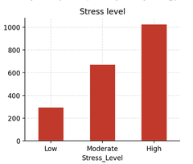

Slide 15
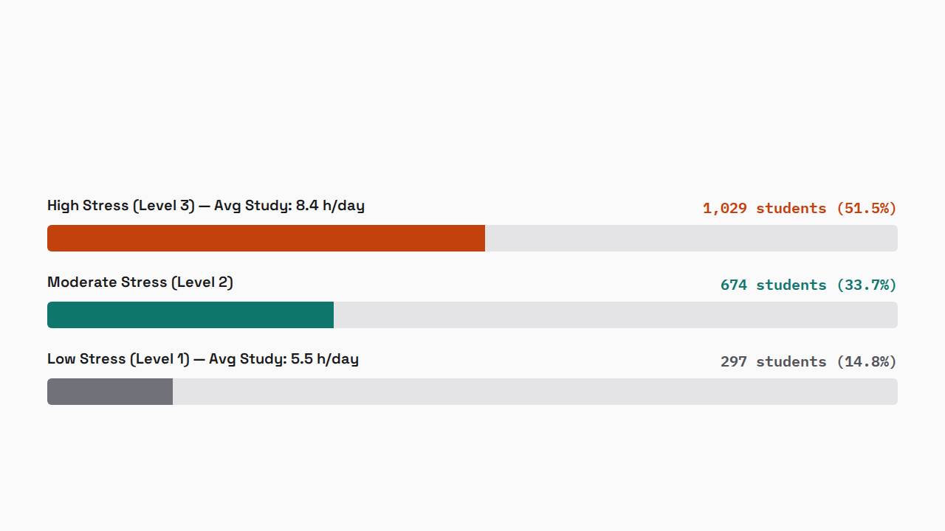
02 / COHORT BREAKDOWN
Over Half of Students Report High Stress

Slide 16

02 / STRUCTURAL CONSTRAINT
Exact 24-Hour Identity Across All Students
Because the five daily time-use columns sum to 24.0 for every row, they are perfectly collinear with the regression intercept.

Slide 17
02 / MATRIX REGULARIZATION
Fixing the Singular OLS Design Matrix
Initial Naive Specification
Reference-Category Specification
•
Predictors: All 5 hour columns + intercept.
•
Omitted Baseline: Social Hours dropped.
•
Condition Number: 7 × 10¹⁵ (Singular).
•
Condition Number: 162 (Well-conditioned).
•
Variance Inflation: Infinite VIFs.
•
Variance Inflation: All VIFs < 3.2.
•
Result: Unstable, meaningless coefficients.
•
Interpretation: +1h activity replacing social time.

Slide 18
SECTION 03
Exploratory Data Analysis & Correlations

Slide 19
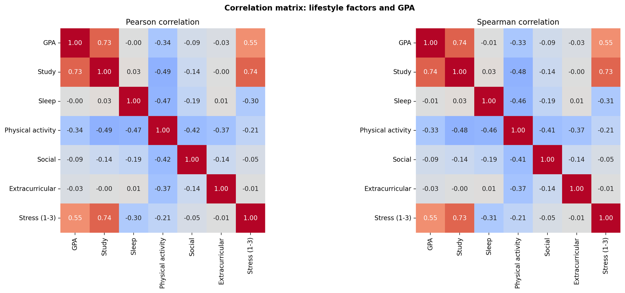

Slide 20
03 / CORRELATION MATRIX
Pearson & Spearman Correlations with GPA
Lifestyle Variable | Pearson r (GPA) | Spearman ρ (GPA) | Pearson r (Study) | Pearson r (Sleep)
Study Hours | +0.73 | +0.74 | 1.00 | +0.03
Stress Level (1–3) | +0.55 | +0.55 | +0.74 | -0.30
Physical Activity | -0.34 | -0.33 | -0.49 | -0.47
Social Hours | -0.09 | -0.09 | -0.14 | -0.19
Extracurricular | -0.03 | -0.03 | -0.00 | +0.01
Sleep Hours | 0.00 | -0.01 | +0.03 | 1.00

Slide 21
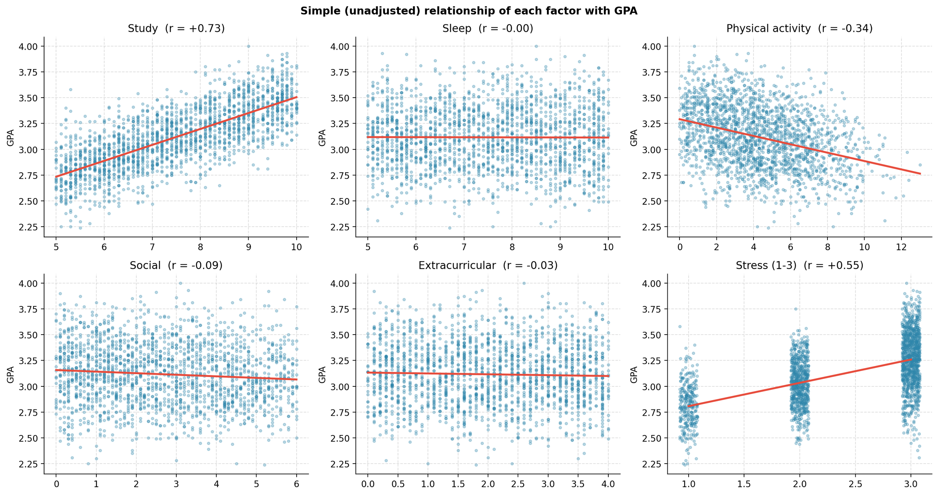

Slide 22
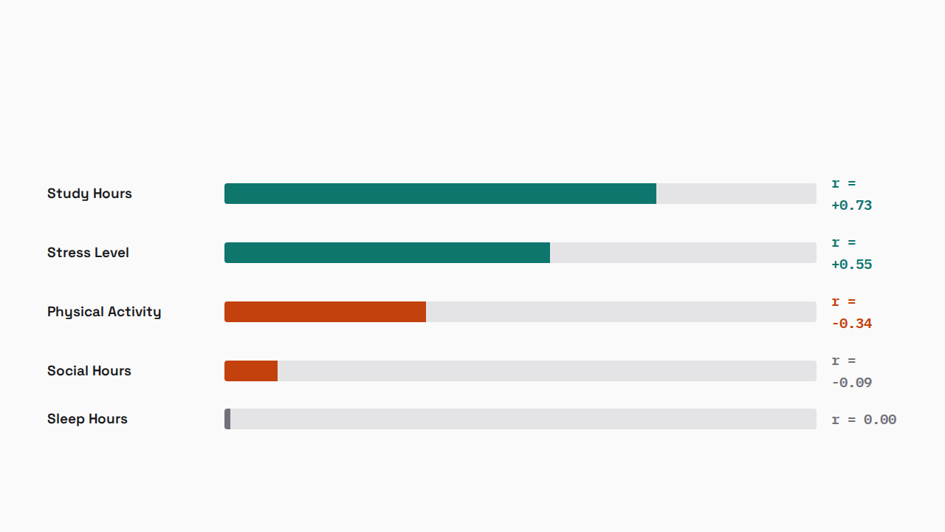
03 / BIVARIATE ASSOCIATIONS
Unadjusted Linear Correlations with GPA

Slide 23
03 / CONTRASTING SLOPES
Study Hours Climb Steeply While Sleep Remains Flat
STUDY HOURS (5–10 h/day)
SLEEP HOURS (5–10 h/day)
r = +0.73
r = 0.00
Mean GPA rises linearly from ~2.73 at 5 hours to ~3.50 at 10 hours of daily study.
Horizontal regression line at GPA 3.12 across the entire 5 to 10 hour sleep spectrum.

Slide 24
03 / CONFOUNDING MECHANICS
Why Activity and Stress Appear Linked to GPA
Time Crowding
Study Drives Stress
Spurious Raw Links
More study leaves less exercise time (r = -0.49).
Study hours explain 55% of stress variance.
Both correlations vanish under study control.

Slide 25
SECTION 04
Regression Modeling & Hypothesis Verdicts

Slide 26
04 / MODEL SUITE
OLS Model Comparison Across Specifications (n = 2,000)
Model Specification | Adjusted R² | AIC | BIC | 5-Fold CV R²
M1: Study Only | 0.5392 | -705.5 | -694.3 | 0.5370
M4: Study + Sleep | 0.5396 | -706.0 | -689.2 | 0.5371
M5: Study × Sleep Interaction | 0.5401 | -707.2 | -684.8 | —
M6: Full Model (Social Ref.) | 0.5398 | -704.1 | -670.5 | 0.5365

Slide 27
04 / FULL MODEL M6
Multivariable OLS Estimates (Social Hours = Reference)
Predictor | Coef. (b) | Std. Error | Std. Coef. (β) | p-value
Study Hours | +0.1530 | 0.0057 | +0.729 | < 10⁻¹⁶
Sleep Hours | -0.0058 | 0.0041 | -0.029 | 0.157
Physical Activity | -0.0013 | 0.0028 | -0.011 | 0.638
Extracurricular | -0.0088 | 0.0045 | -0.034 | 0.051
Stress (per level) | +0.0002 | 0.0105 | +0.001 | 0.984

Slide 28
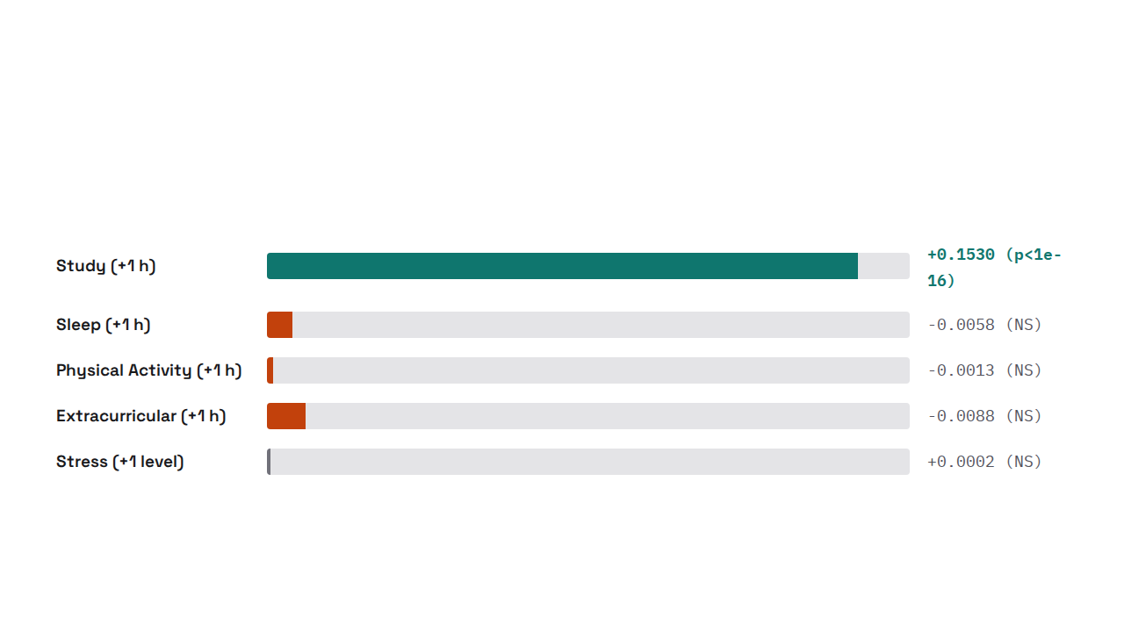
04 / EFFECT SIZES
Full-Model Coefficients (GPA Change per +1 Unit)

Slide 29
04 / HYPOTHESIS H1
H1 Verdict: Study Supported, Sleep Rejected
SUPPORTED HALF
REJECTED HALF
Study Hours Drive GPA
Sleep Shows Zero Effect
•
Slope: b = +0.154 GPA per hour.
•
Unadjusted: b = -0.0009 (p = 0.85).
•
Significance: p < 10⁻¹⁶.
•
Adjusted for Study: b = -0.005 (p = 0.12).
•
Variance Explained: R² = 0.539 alone.
•
Conclusion: No linear sleep-GPA link.

Slide 30
04 / HYPOTHESIS H2
H2 Verdict: Activity & Social Effects Collapse
Unadjusted Bivariate Slopes
Controlled for Study Hours
•
Physical Activity: b = -0.041 (p < 10⁻¹⁶).
•
Physical Activity: b = +0.003 (p = 0.19).
•
Social Time: b = -0.015 (p = 10⁻⁴).
•
Social Time: b = +0.003 (p = 0.30).
•
Illusion: Appears harmful to grades.
•
Verdict: Pure time-displacement artifact.

Slide 31
04 / HYPOTHESIS H3
H3 Verdict: No Significant Study × Sleep Interaction
p = 0.072
Interaction coefficient b = +0.004 (Δ Adjusted R² = +0.0005)
For sleep < 6h subgroup (n = 402), interaction p = 0.88. Not supported at 5% level.

Slide 32
04 / HYPOTHESIS H4
H4 Verdict: Full Model Adds Zero Predictive Power
F = 1.66
p = 0.158
0.537
-694.3
Nested F-Test Statistic
No Improvement Over M1
Identical 5-Fold CV R²
BIC Prefers Study-Only

Slide 33
SECTION 05
Limitations, Synthetic Signatures & Reproducibility

Slide 34
05 / DATA FORENSICS
Evidence That the Kaggle Dataset Is Simulated
Exact 24h Sums
Textbook Residuals
Exact Zero Slopes
Ceiling Truncation
Every row totals 24.0 hours.
Purely Gaussian linear noise.
Non-study factors equal zero.
Single point capped at 4.00.

Slide 35
05 / SCOPE CONSTRAINTS
External Validity & Measurement Limitations
Unmeasured Dimensions
Association vs. Causation
•
Missing Screen Time: Cannot test digital distraction.
Cross-sectional observational data cannot establish causality. High stress is a byproduct of heavy study schedules rather than a driver of grades.
•
Sleep Quality Omitted: Duration ignores rest timing.
•
Restricted Sleep Band: Truncated at 5–10 hours.

Slide 36
05 / REPRODUCIBILITY
End-to-End Automated Pipeline (python run_all.py)
MODULE 01
MODULE 02
MODULE 03
data_preprocessing.py
correlation_map.py
run_all.py
Cleans raw CSV and encodes stress.
Exports 300-DPI heatmaps and scatters.
Regenerates all OLS models and figures.

Slide 37
05 / FINAL SYNTHESIS
Five Core Conclusions from Team 26
•
Single Dominant Driver: Study hours (+0.154 GPA/h) explain 54% of GPA variance.
•
Compositional Constraint: Exact 24-hour budgets require dropping a reference variable.
•
Confounded Correlations: Exercise and stress links vanish once study load is controlled.
•
Parsimony Wins: Simple study-only regression matches the full multivariable model.

Slide 38
CS215 • GROUP 26 • Sinde-Chetan/DAI_CS215_Project
Thank You
Chetan • Karthik • Mukesh • Rishanth | Mentor: Namish Bansal

